Slide 1
Analog & Digital Communication Systems
Week 2

Slide 2
Recap
Introduction of Communication Systems
Communication System model
Attenuation, Distortion and Noise
Messages
Noise immunity
Analog to Digital conversion
Sampling
Quantization
Encoding
Bandwidth
Channel Capacity
Rate of communication
Signal to noise ratio

Slide 3
Compression of Signal
Signal compression is the use of various techniques to increase the quality or quantity of signal parameters transmitted through a given telecommunications channel.
Compressing a signal in time by a factor of 2 allows it to be transmitted in half time, and transmission speed doubles.
More generally, if a channel of bandwidth B can transmit N pulses per second, then to transmit KN pulses per second by means of the same technology, we need a channel of bandwidth KB.
Thus, the number of pulses per second that can be transmitted over a channel is directly proportional to its bandwidth B.

Slide 4
MODULATION
Baseband signals produced by various information sources are not always suitable for direct transmission over a given channel.
When signal and channel frequency bands don’t match, channels cannot be moved. Hence messages must be moved to the right channel frequency bandwidth.
These signals are usually further modified to facilitate transmission. This conversion process is known as modulation
In this process, the baseband signal is used to modify some parameter of a high-frequency carrier signal.

Slide 5
MODULATION
A carrier is a sinusoid of high frequency, and one of its parameters-such as amplitude, frequency, or phase-is varied in proportion to the baseband signal m(t).
For example, amplitude modulation (AM) and frequency modulation (FM).
At the receiver, the modulated signal must pass through a reverse process called demodulation in order to reconstruct the baseband signal.

Slide 7
Randomness, Redundancy, and Coding
Randomness means unpredictability , or uncertainty, of a source message.
Because of redundancy, we are able to decode a message accurately despite errors in the received message.
Binary data can be transmitted using a number of different types of pulses. The choice of a particular pair of pulses to represent the symbols 1 and 0 is called Line Coding.

Slide 8
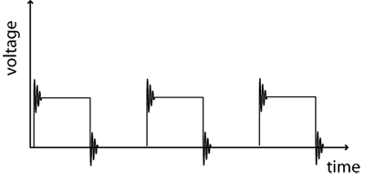
Signal and system
Signal
Signal is a set of Information / Data
For example, Telephone, Telegraph, Stock Market Price
A signal is a time-varying quantity of information or data.
Here a signal is represented by a function g(t) of the independent time variable t.

Slide 9
Signal and system
System
System process the received signal
System might modify or extract information from signal
For example, Anti aircraft missile launcher may want to know the future location of target
Anti aircraft missile launcher gets information from radar (INPUT)
Radar provides target past location and velocity

Slide 10
Signal and system
System
Anti aircraft missile launcher calculates the future location (OUTPUT) using the received information
Definition
System gets a set of signals as INPUT and yield a set of signals as OUTPUT after processing
System might be a physical device or it might be an algorithm

Slide 11

Size of Signal
Size of an entity is a quantity/number that shows largeness or strength of that entity.
How signal (amplitude and duration) can be represented by a single number measure?
Such a measure must consider not only the signal amplitude but also its duration.
For example, person’s width ‘r’ and height ‘h’
To be more precise, single value measure of a person is its volume

Slide 12
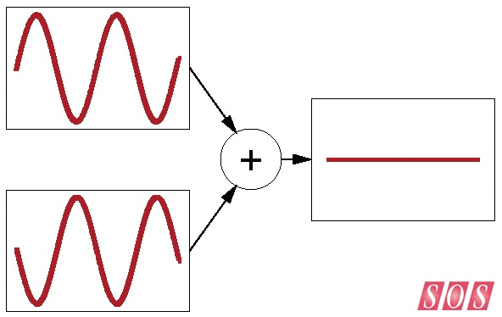
Size of Signal
Signal Energy
Area under a signal g(t) is a possible measure of its size
Signal Size takes two values “Amplitude” and “Duration”
This measuring approach is defective for large signals having positive and negative portions.

Slide 13
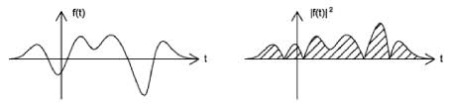
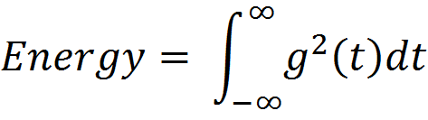
Size of Signal
Signal Energy
Positive and negative portions might cancel each other, wrongly indicating a signal of small size.
This can be solved by calculating area under g²(t). This measure is called energy of the signal.

Slide 14
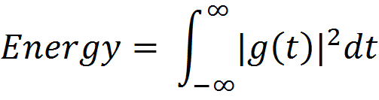
Size of Signal
Signal Energy
The definition can be generalized to a complex valued signal g(t) as
Other possible approach is area under |g(t)|
However, energy measure is more desirable in the sense that it is indicative of the signal energy.

Slide 15
Size of Signal
Signal energy must be finite for it to be meaningful measure of signal size.
Necessary condition for energy to be finite.
Signal amplitude approaches zero as time approaches infinity
If signal amplitude does not approach zero, then signal energy is infinite.

Slide 16
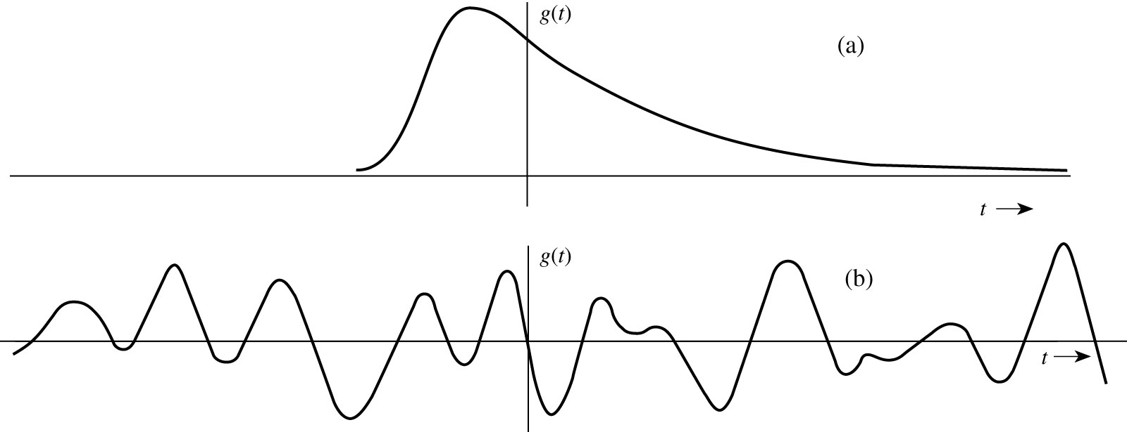
Size of Signal
(a) Signal with finite energy (b) Signal with infinite energy

Slide 17
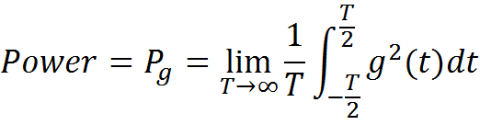
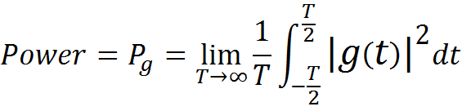
Size of Signal
Signal Power
A more meaningful measure of the signal size in such a case would be the time average of signal energy is taken into consideration, which is the average power (P_{g})of the signal.
This definition can be generalized for complex signals as
Signal power is the time average of signal amplitude.

Slide 18
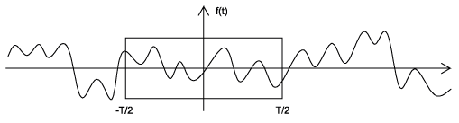
Size of Signal
Square root of signal power is the Root Mean Square (RMS) value of signal

Slide 19
Size of Signal
Are all energy signals also power signals?
No. In fact, any signal with finite energy will have zero power.
Are all power signals also energy signals?
No. Any signal with non-zero power will have infinite energy.
Are all signals either energy or power signals?
No. For example, ramp signal g(t) = t increases indefinitely as |t| approaches infinity, and neither the energy, nor the power exists for this signal.

Slide 20
Size of Signal
Remark:
The terms energy and power are not used in their conventional sense as electrical energy or power, but only as a measure for the signal size.

Slide 21
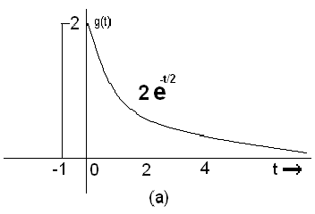
Example 2.1
Determine the suitable measures of the signals given below:
The signal (a) amp. 0 as t infinity .Therefore, the suitable measure for this signal is its energy, given by

Slide 22
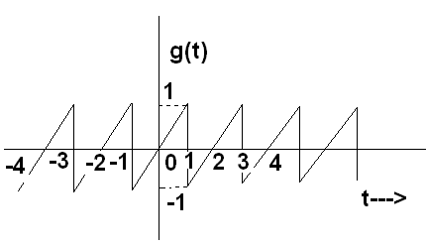


Example 2.1
The signal in the Figure below does not ---→ 0 as t → . However, it is periodic; therefore, its power exits.

Slide 23
Example 2.1
The signal in the Figure below does not ---→ 0 as t → . However, it is periodic; therefore, its power exits.

Slide 24
Summary
Compression
Randomness, Redundancy, and Coding
Signal
System
Size of Signal
Energy
Power
Energy Signal
Power Signal
Suitable measures of signals

Slide 25
Thank you

